Slide 1
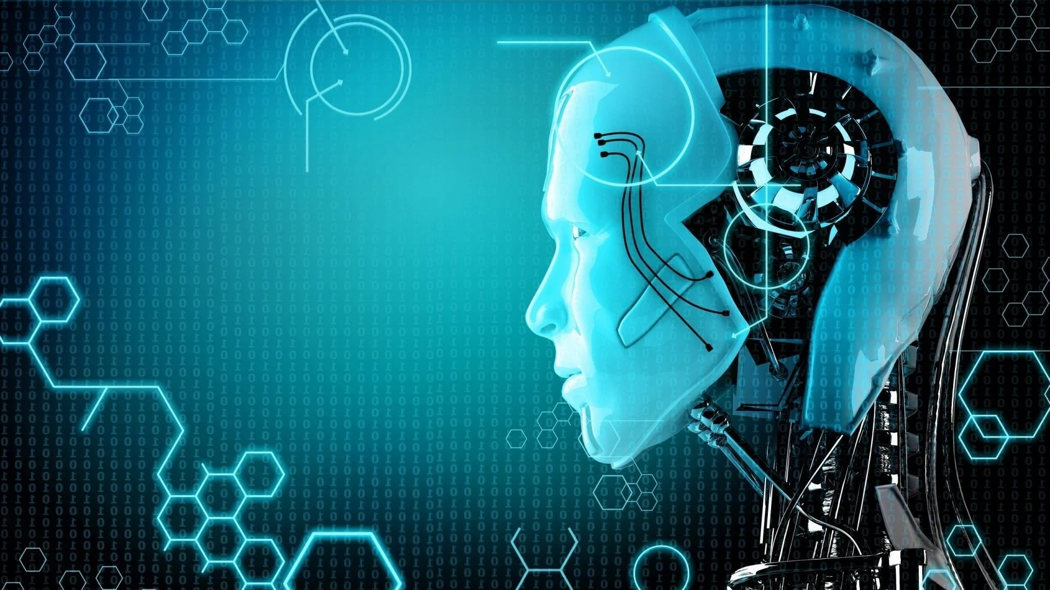
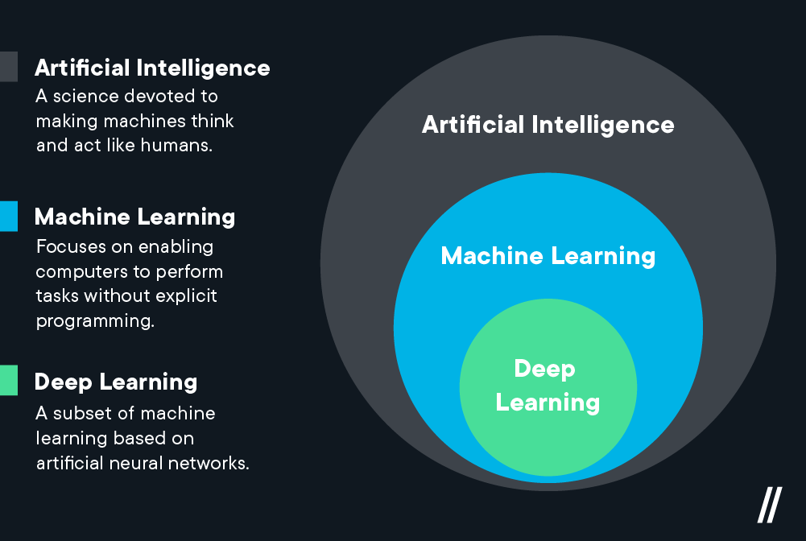
AI for all

Slide 2
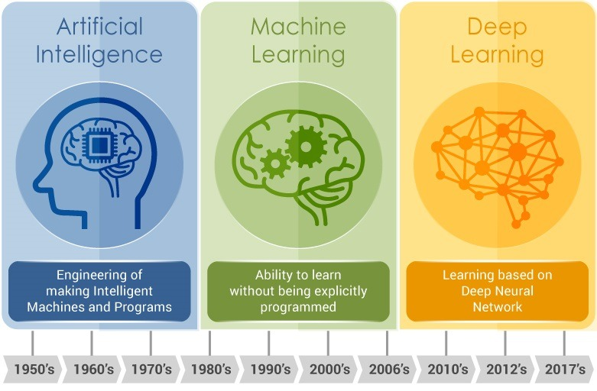
AI for all

Slide 3
AI for all
Types of Deep Learning:
Feedforward neural network.
Radial basis function neural networks.
Multi-layer perceptron.
Convolution neural network (CNN)
Recurrent neural network (RNN)
Modular neural network.
Sequence to sequence models.

Slide 4
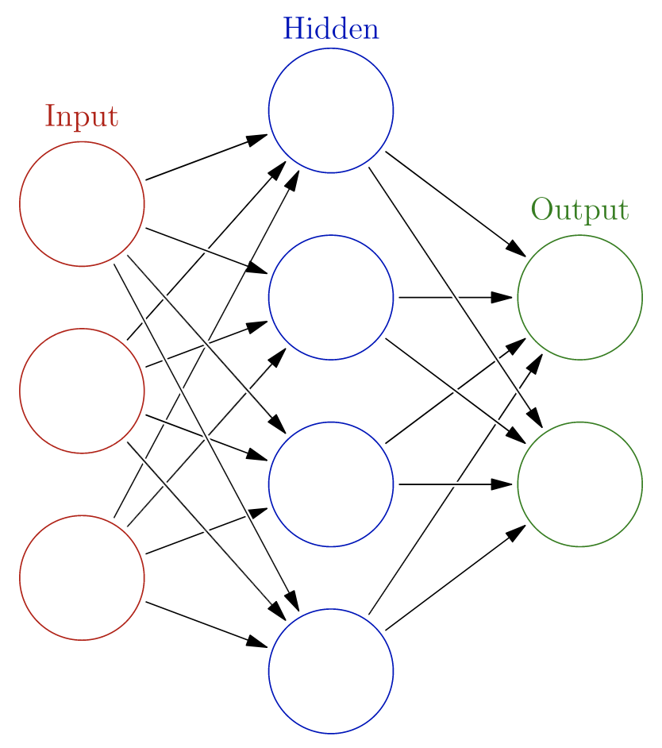
AI for all
Neuron

Slide 5
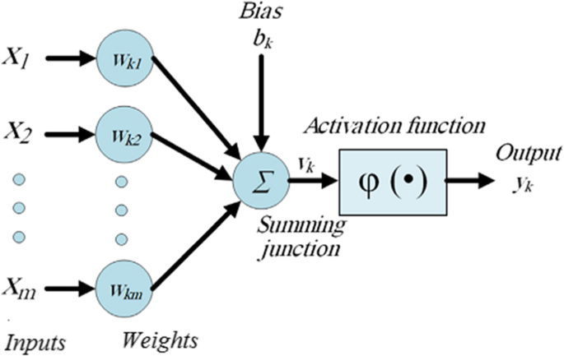
AI for all
Z = activation ( w * x + b )

Slide 6
AI for all
Activation functions:
-Sigmoid
-Tanh
-Relu (rectified linear unit)
-Leaky Relu

Slide 7
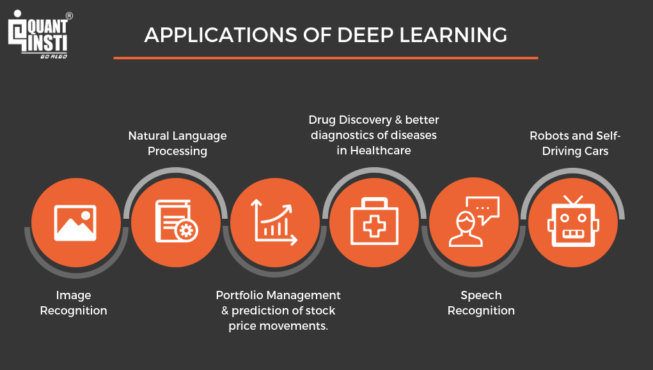
AI for all

